Slide 1
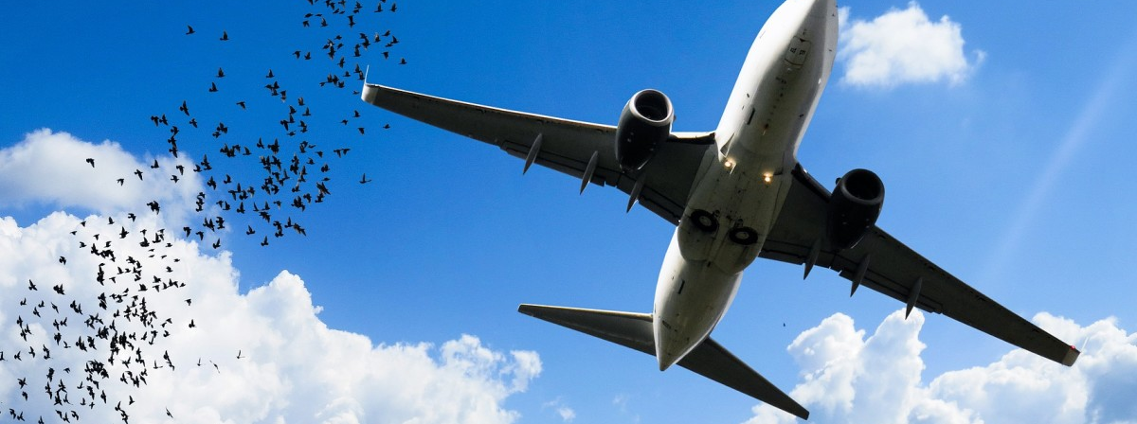
Wildlife Strikes
By:
Lohitha
Pranavi
Mahe Jabeen
Chang Gyun

Slide 2

Here’s What’s Coming
Introduction
Datasets
Methods
Visualizations
Observations
Key learnings
Let’s go!

Slide 3
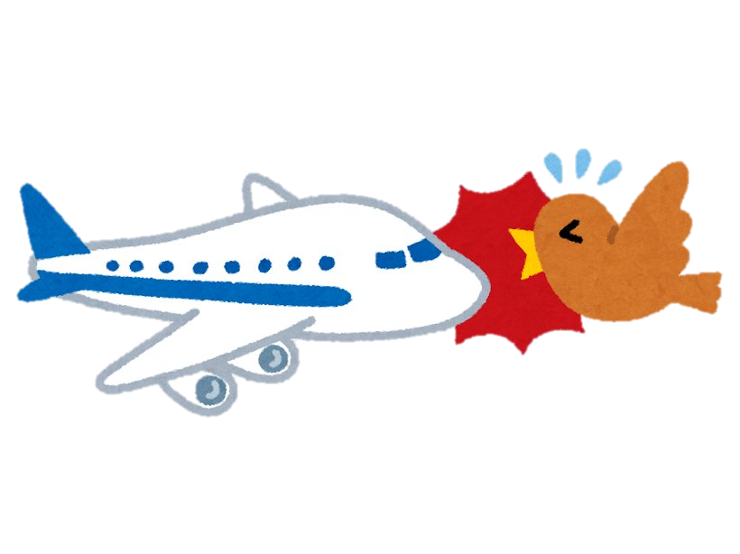
What is a bird strike?
A wildlife strike incident is defined as a collision between an aircraft and an animal during any / all phases of the flight, including those animals killed by the downwash of aircraft.
Wildlife strikes are serious hazards for both civil and military aircraft; military aircraft are under significantly increased risk due to their low flight paths, high velocities and single engines.

Slide 4

Datasets
Wildlife Strikes dataset
Contains data from 1990 to present (2022)
260,000 records, and 100 fields
Location: U.S covering all states
Aviation Dataset
88000 records, and 31 fields
Location: U.S covering all states
US State code mapping
Contains state abbreviations
Since the data contained is voluntarily reported, there is some noisy data is present in both datasets.

Slide 5

Methods
The large number of null and unknown values that skewed the query results. For example, we started cleaning the dataset by excluding null values and unknowns as necessary.
We joined the two datasets Aviation and Wildlife Strikes data using Outer join on column-registration number of the accident.
We also did some data transformations for the effective visualizations.

Slide 6
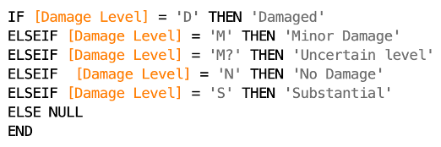

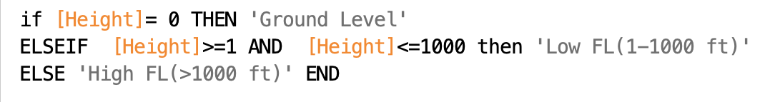


Some examples of Data transformations
‘Damage Level’
‘Total Cost’
‘Feet from Ground level’

Slide 7

Visualizations

Slide 8
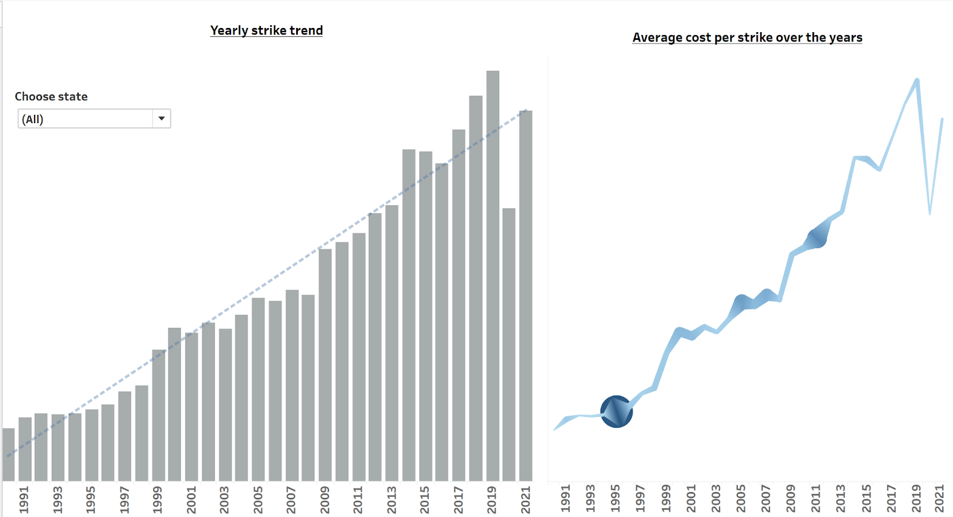
US Bird Strikes yearly trend

Slide 9
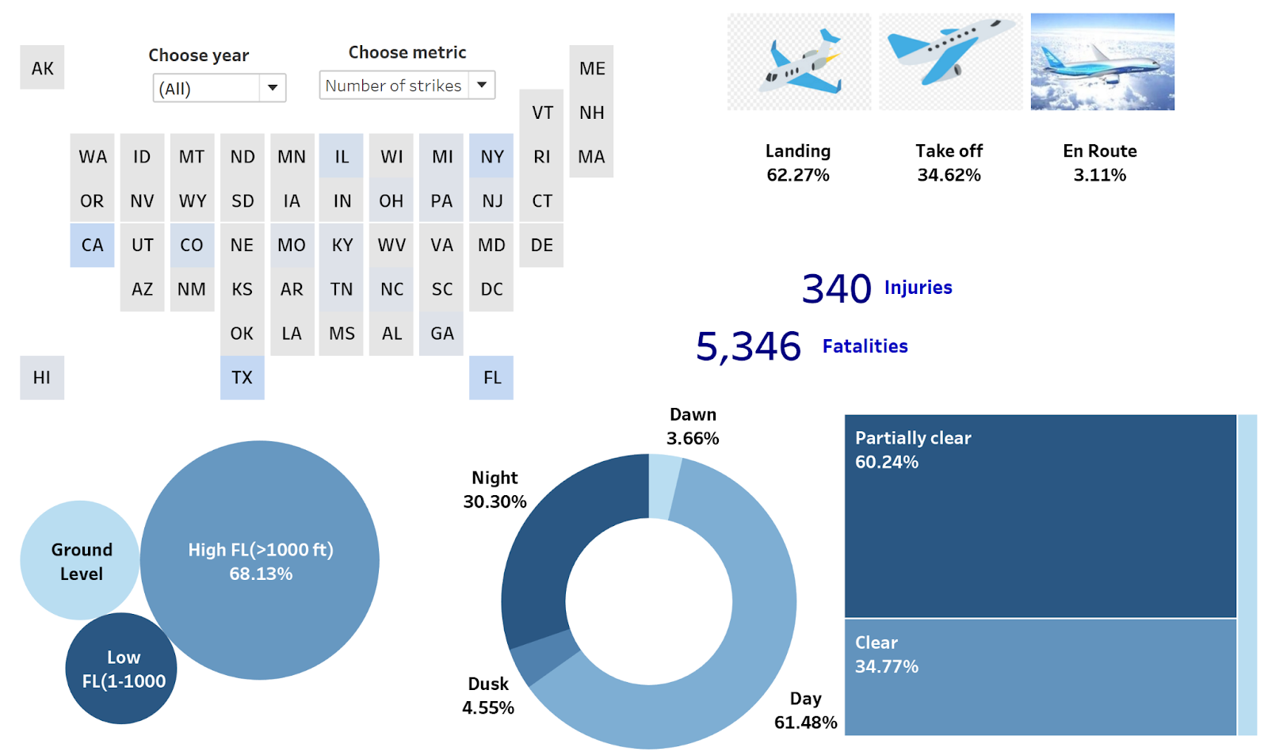
Overview of causes

Slide 10
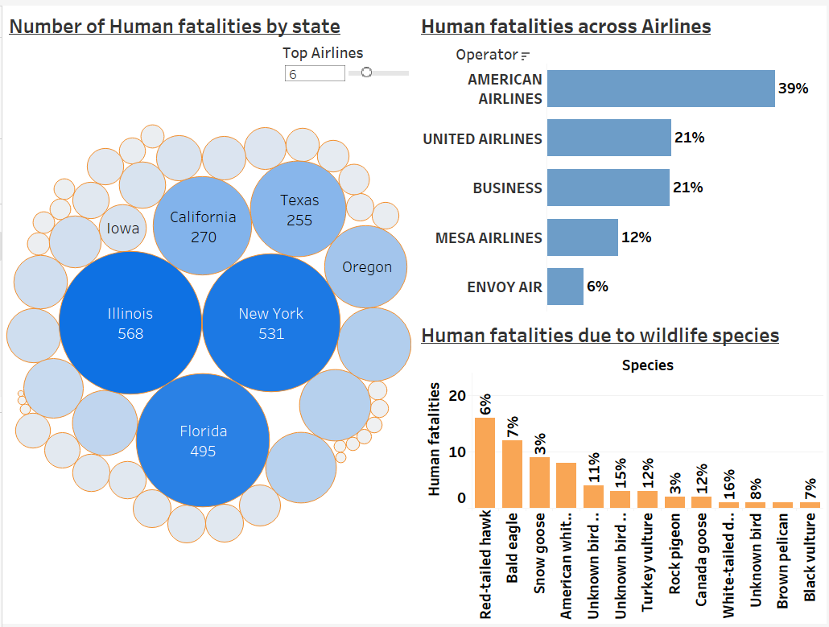
How worse are these strikes?

Slide 11
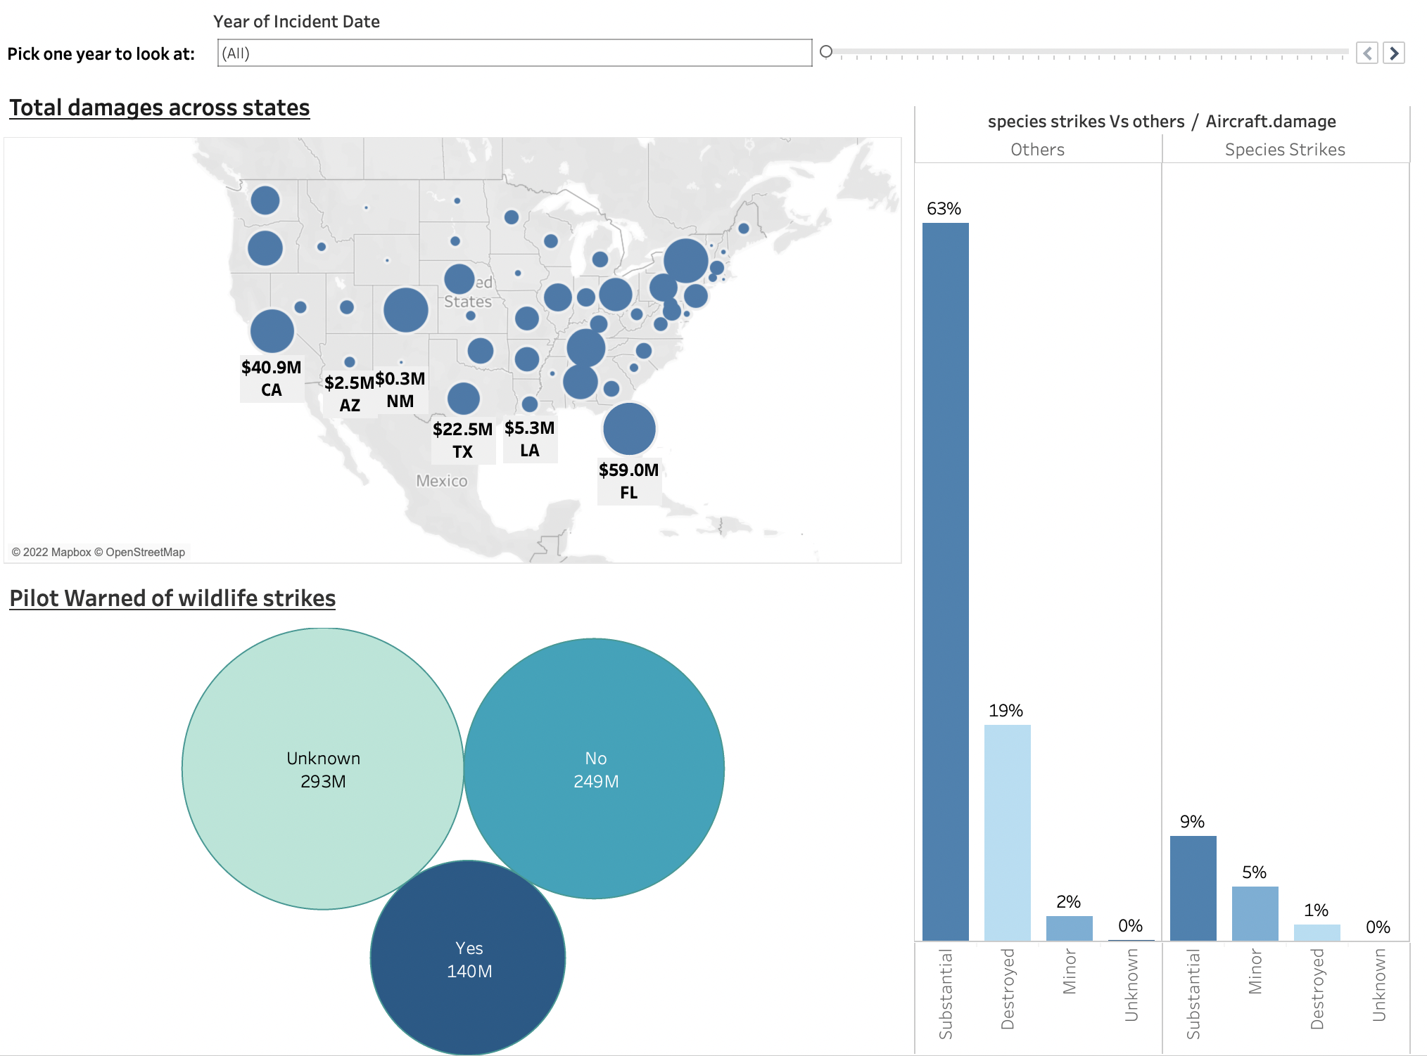
How much damage is caused by birds?

Slide 12
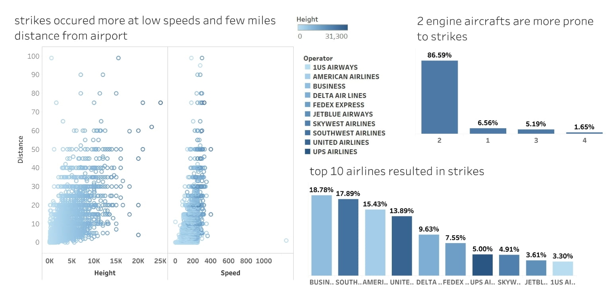
What are the trends in birds?

Slide 13
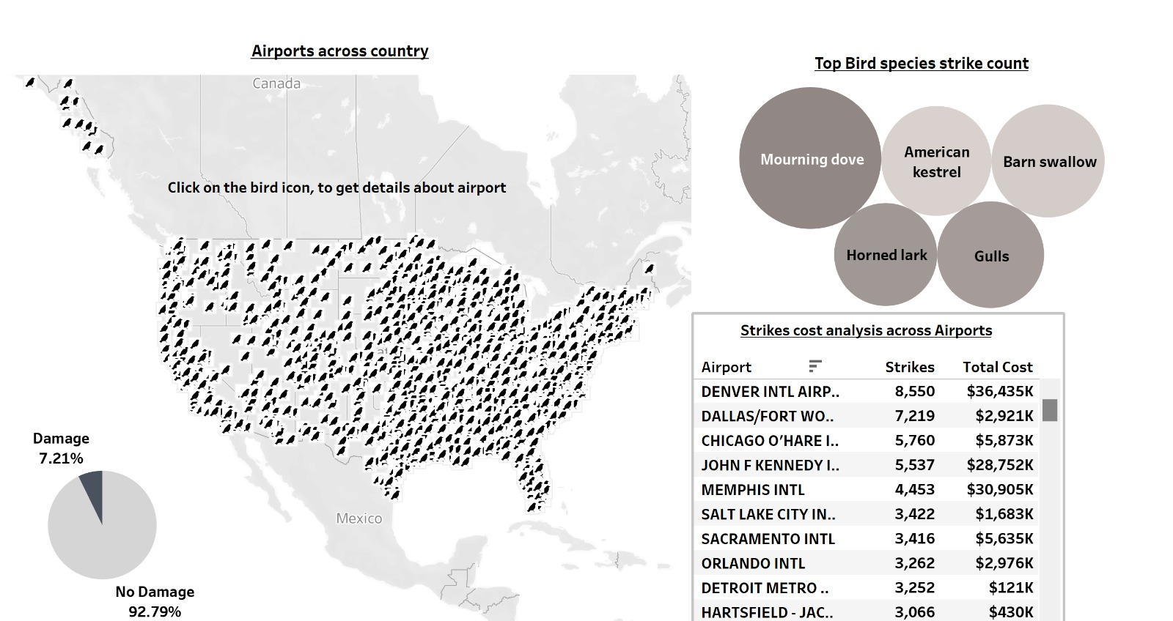
Where are the birds going?

Slide 14
Conclusions and Recommendations
Since most of the incidents occur at approach or departure when the airplanes are at low altitude and closer to the airport, we can minimize the attractiveness of the airport environment to birds by following
1)Modifying the habitat - Removing food sources, such as seed-bearing plants.
2)Controlling bird behavior - Flying trained falcons (or drones) over nesting sites to prevent birds from nesting.
3)Adapting flight times and paths - Adjusting flight times to avoid the busiest hours for bird activity, such as early morning and late evening, or to make alterations during seasonal migration periods.

Slide 15
Conclusions and Recommendations
Using trained birds to ward off the migratory birds from the airport locations can be a useful tool to reduce bird strikes.
Since the modern commercial jets are faster and less noisier they often go undetected by the birds which results in bird strikes. The Aviation industry can add pulsating lights in the aircraft wings that have found to reduce the air strikes in other parts of the world.
The airlines industry can study the migratory birds pattern and routes in the summer seasons. Avoiding such routes if possible could result in reduced bird strikes.

Slide 16
Conclusions and Recommendations
Training dogs to track through the airport and surrounding area as a visible threat
Closer monitoring, greater understanding and more targeted action is needed to counteract the fact that airports are getting busier, more flights are being scheduled and alternative habitats for birds are shrinking.

Slide 17
Challenges
✈ One of the challenges was the normalization of the data to make suitable comparisons for the bird strikes in different months
✈ There were some columns with missing data values and there were a few columns that lacked information and the data was taken from FAA website.

